Slide 1
Image Album Application
Ante Hakstok
Antonio Labriola
Marko Pancirov
Ana Hakstok

Slide 2
Classes
We have four classes each with a single responsibility in support of the Separation of Concerns principle. The focus is on low coupling and high cohesion.
We decided to refactor our Image Album Application in C# because C# offers better and more easier image processing abilities so we didn’t have to use any libraries like we had to use before in Java. Instead we used simple C# bitmap processing from the following project:
http://www.codeproject.com/Articles/33838/Image-Processing-using-C

Slide 3
Classes – cont.
Album
A collection of Image objects, can add and delete images from that collection. It aggregates Image objects.
Image
Represents the image. It is used to create image objects.
stores data about the image like its size, name, path and labels associated with it. It also has standard getters and setters for these fields.
ImageEditor
Editor class handles image manipulation that is on the front end done by the user. It takes an image object that needs to be edited from the controller class as well as the information about the type of editing(crop, flip, mirror, and rotate images), and afterwards returns the altered image object to the controller. It actually stores a reference of the image being edited.
ImageAlbum
This is a controller class(main method will be in this class) used to run the application. It creates and stores all objects created by using the other classes. It also displays the images for the user to interact with. This class is like a facade for the entire application because the user or other developer can interact with all other classes within this class in a simplified manner.

Slide 4
Responsibilities and collaborators
ImageAlbum collaborates with all other classes, it uses Image class to create Image objects, ImageEditor to manipulate images and Album to aggregate them.
ImageEditor retains a reference to the Image object that is being edited.
Image class is used by all other classes. ImageEditor uses it to manipulate with the image, Album aggregates images and ImageAlbum creates and handles Image objects.
Album is just a collection of Image objects.

Slide 5
Class Diagram

Slide 6
Sequence Diagram

Slide 7
Multiple image file formats
Builder pattern
The user can now save the image in three formats: PNG, GIF, JPG
The Image class uses the buildPicture() method which is called inside of the save() method. This method calls the builder methods.
The ConcreteBuilders are JPEGBuilder, PNGBuilder and GIFBuilder
In regards to the Builder Pattern:
Director: Image
Client: ImageAlbum
Builder interface: Builder
Concrete Builders: JPEGBuilder, PNGBuilder, GIFBuilder

Slide 8
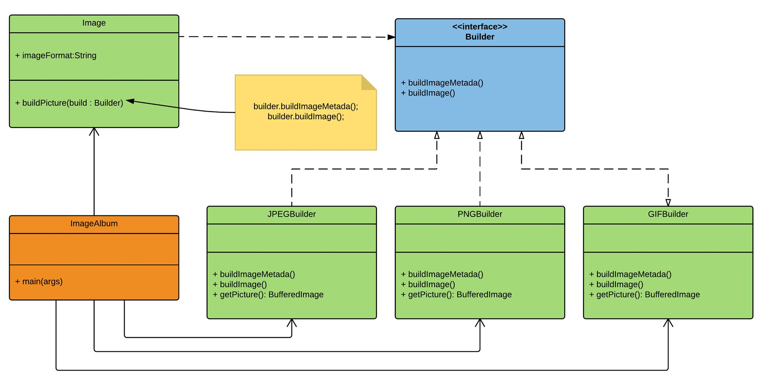
Class diagram - multiple image file formats

Slide 9
Saving image data in multiple file formats
Factory pattern
We want to be able to save image data(name, path etc.) in different file formats.
In this case we want CSV, JSON and HTML.
ImageAlbum is the client which uses ImageDataFactory to create different file formats for the image data. We have ImageData interface that requires the encode() method to be implemented. This method encodes data in a desired format. For example, JSONData encodes image data in JSON format.
If we want to add a new format, we just need to implement the ImageData and ImageDataFactory interfaces.
In our case we implemented the JSON format for storing image data

Slide 10
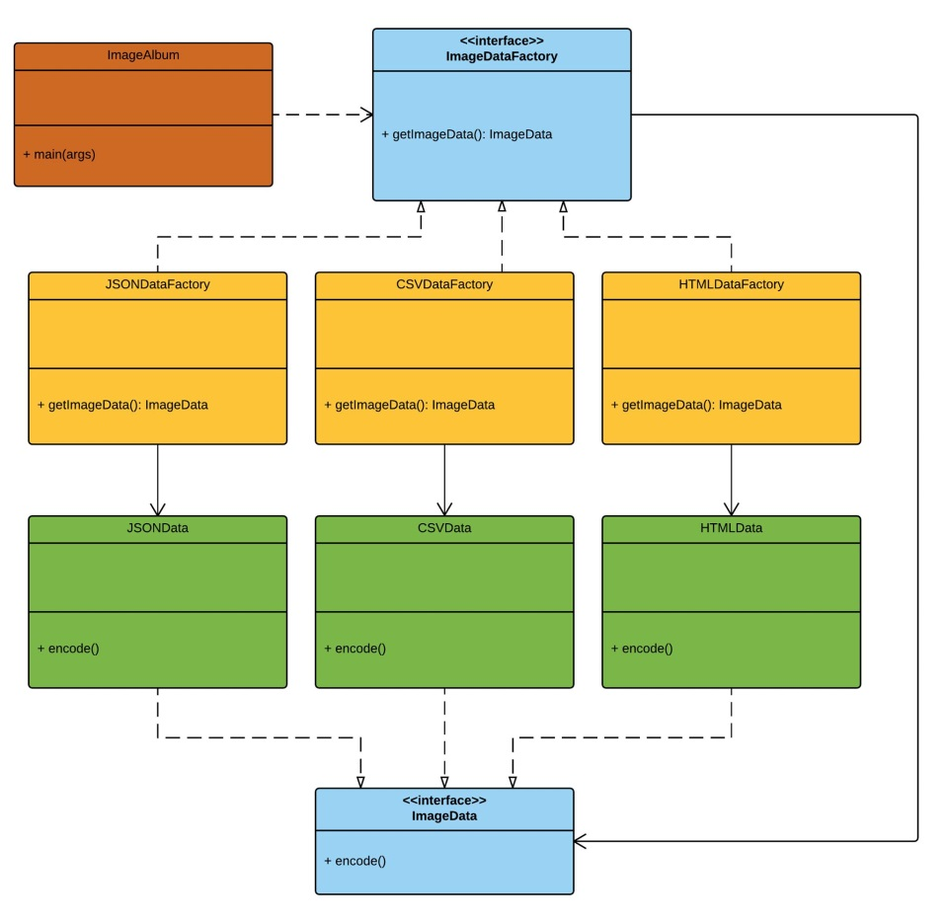
Class diagram - multiple image data file formats

